Slide 1

Campus Network Firewall
Group: AccessDenied
Bob Wei and Sarah Shibley
CECS 478

Slide 2
Campus Network Filter
Proposal:
The idea of our proposal is to provide security to a potentially unsecured network. We want to free our client from having to worry about intrusion and malicious network traffic.
The idea is to uses a piece of hardware to act as a firewall, secure private network and provide security policy for the unsecured network. This could be via a network device that can connect to a public network service, or a server that can be accessed by a vpn connection.

Slide 3
Accomplishments:
Network Address Translation (NAT)
Block/Allow specific protocols and ports
Blacklist Domains/IPs
Block packets with invalid tcp flags
Block DOS attacks

Slide 4
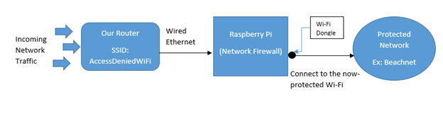
Our setup:

Slide 5
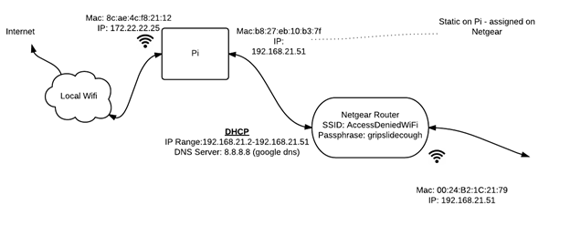
Our Setup: Personal Mode

Slide 6
Pros and Cons

Slide 7
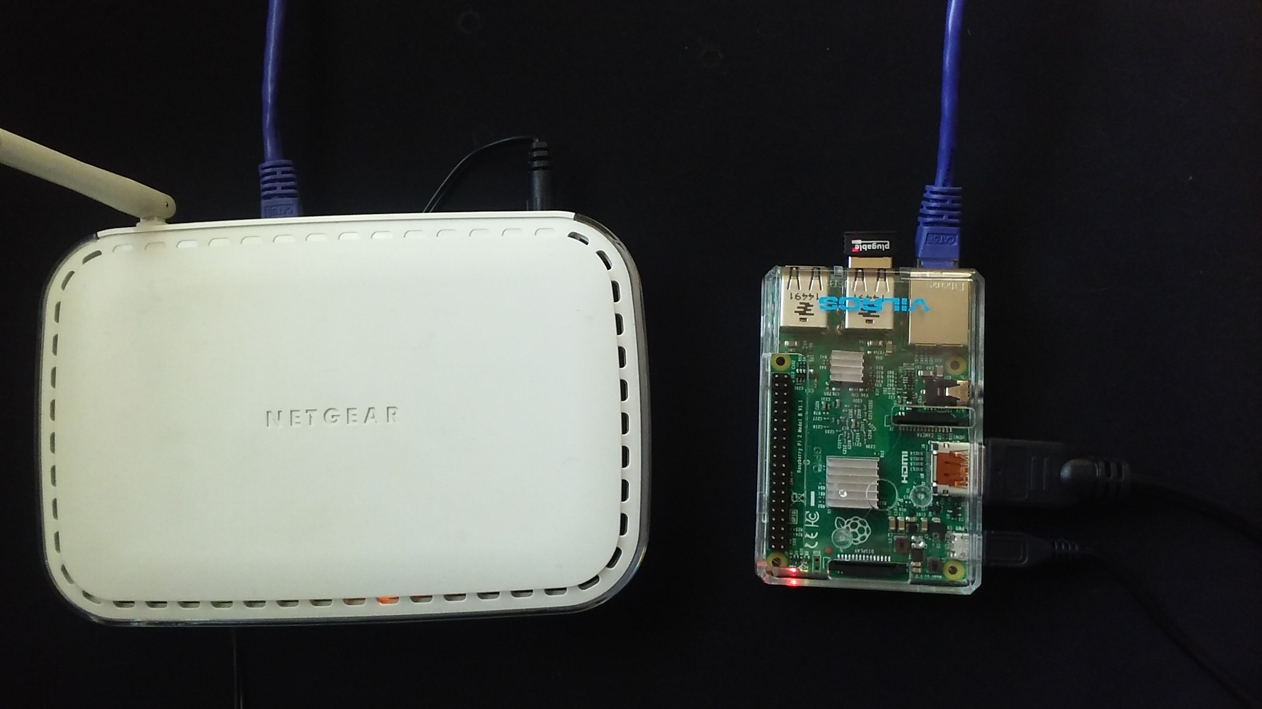
Resources
Hardware:
Raspberry Pi (Version 2B)
WiFi Dongle
Netgear Router (wired to Pi by Ethernet cable)
Software:
iptables (Packet Filter)
Snort (NIDS)
Wireshark (Packet Analyzer)
SquidGuard

Slide 8
Campus Network Filter
Timeline / History
Server Setup
setup OS and initial configuration
connecting to both internal router and external Wifi
Scripting
IPTables scripts
Snort setup and testing
Squidguard implementation

Slide 9
Blocking DOS Attacks
Identify Threat
Any IP address that sends too many packets in a certain amount of time
Log the ip and packet
Log Threat
keep track of when DOS attacks occur
Log Source IP Address, port #, protocol, and packet data

Slide 10
Blocking DOS Attacks
Block threat
Add IP address to list of offenders
Drop all packets from ip addresses on Offender List
Give offenders a second chance … later
After a set period of time allow offending iPs to retry. If they continue to DOS they are put back on Offender List

Slide 11
Blocking DDOS Attacks:
Thus far: Impossible. No one knows how to block DDOS attacks
However, there are some measures to prepare and decrease the damage done.
Many of these measures are expensive and difficult to implement so often only large companies can implement them

Slide 12
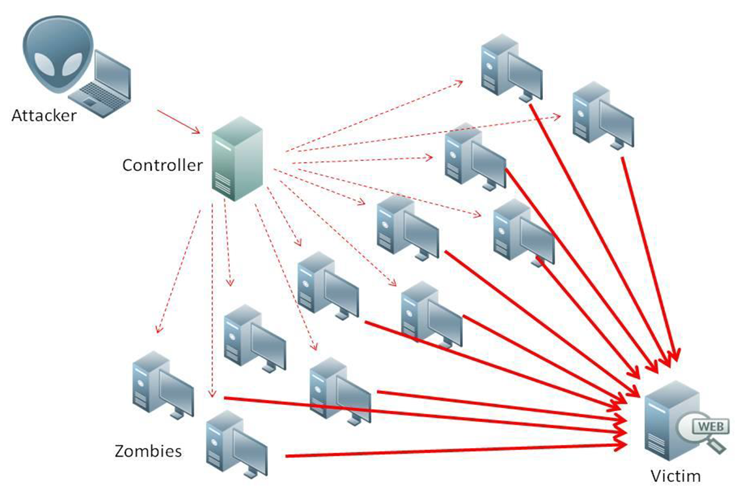
Blocking DDOS Attacks
Use the best Network Infrastructure:
handle the load better
Determine System Bottlenecks:
Server, Firewall, Internet Connection, etc.
Monitor Network:
know when you are being attacked
Friends in High Places:
Know who to call at your ISP

Slide 13

DEMO: DOS Attack
LOIC - Low Orbit Ion Cannon
a tool used by Anonymous for DDOS attacks
Generates a DOS attack to a specified IP Address and port #
Specify speed, and # of threads

Slide 14
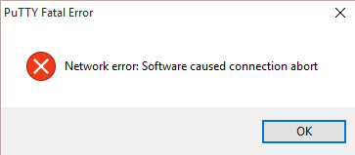
Challenges
Many Hardware Issues
Difficult to configure Pi to listen on two interfaces and pass traffic through
Server went down often - Network issues and unknown reasons
Memory and Processor limitations for Pi
Remote Login
During firewall configuration we were often too good - kicked ourselves off
often had to reset the server to get back on
Other…
Keyboard language change… Don’t ever do that

Slide 15
Campus Network Filter
Current State -
Where to go from here?
Client side development
employing passwords and key exchanges
enforce network interface on client side

Slide 16
Questions???

